Slide 1
Challengers
Sprint 3 Presentation

Slide 2
Introduction to flexbox
The flex container properties are:
flex-direction.
flex-wrap.
flex-flow.
justify-content.
align-items.
align-content.

Slide 3
Overview
In our website we used almost the same flex properties for all three pages,and these are some of the properties that we used:
text-align
Fieldset
Align -items
Justify-content

Slide 4
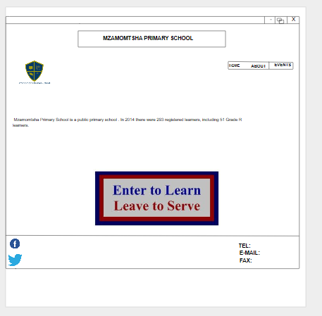
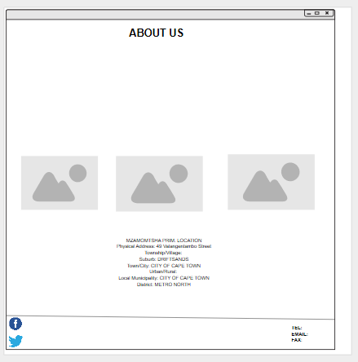
Moqup diagram

Slide 5
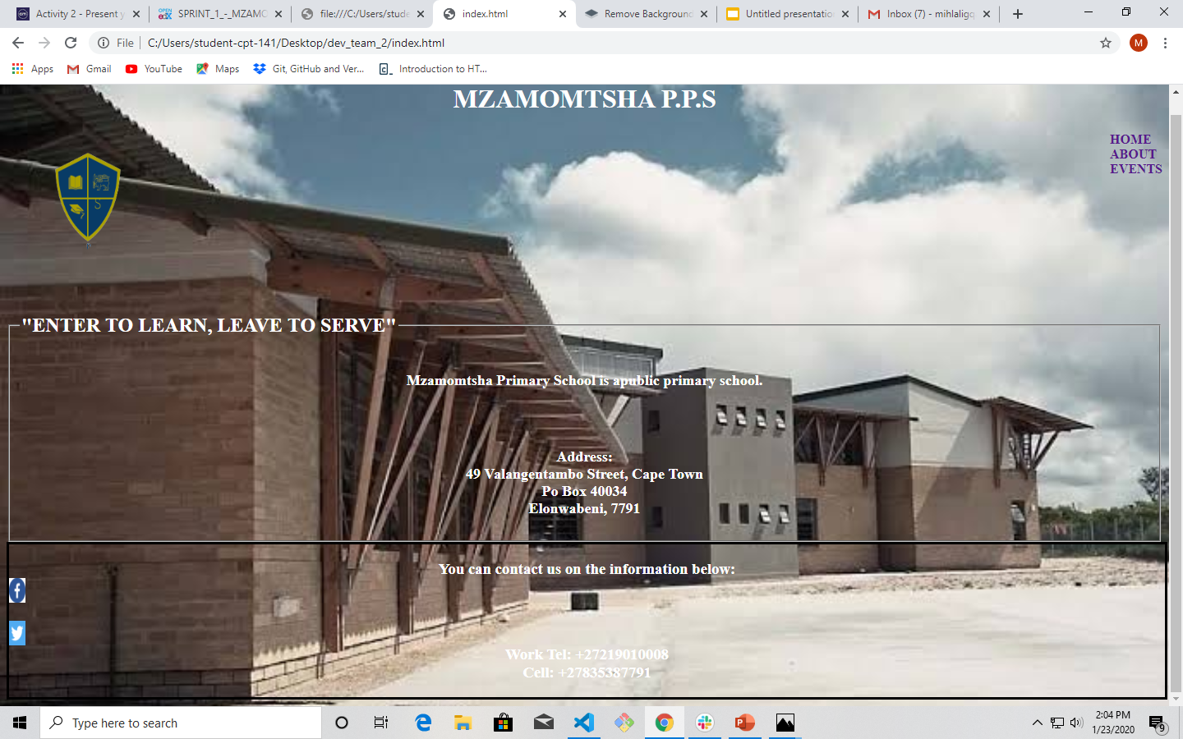
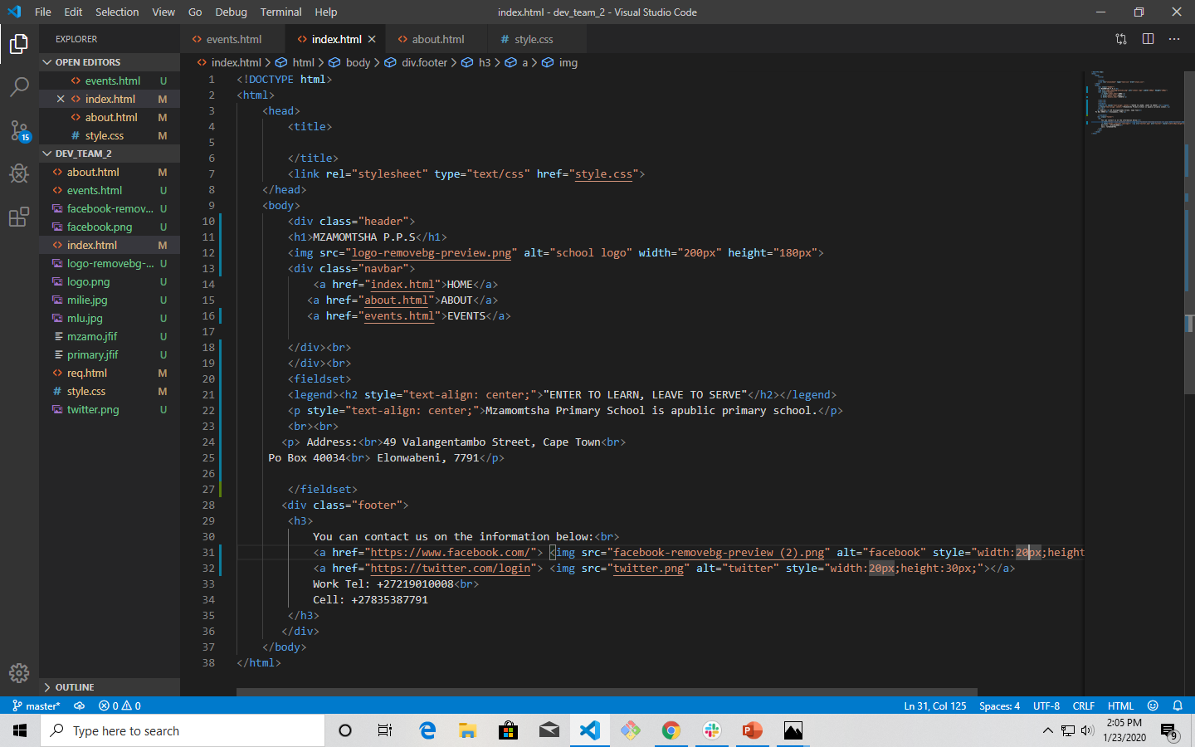
Flexbox Main Page Design

Slide 6
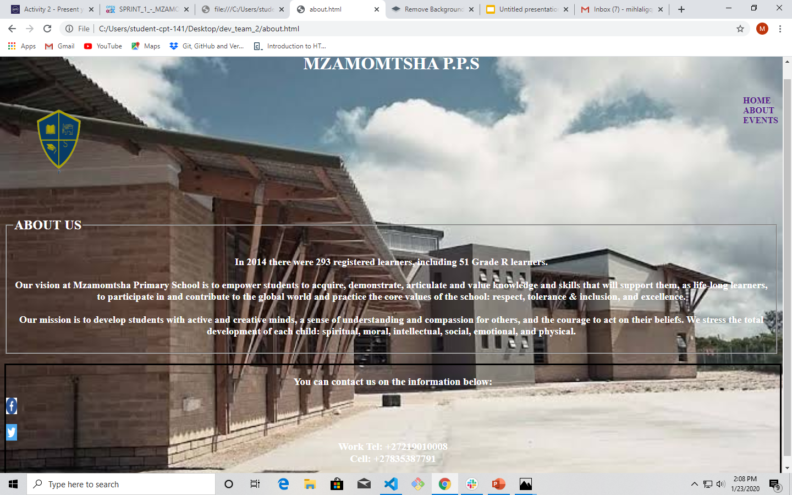
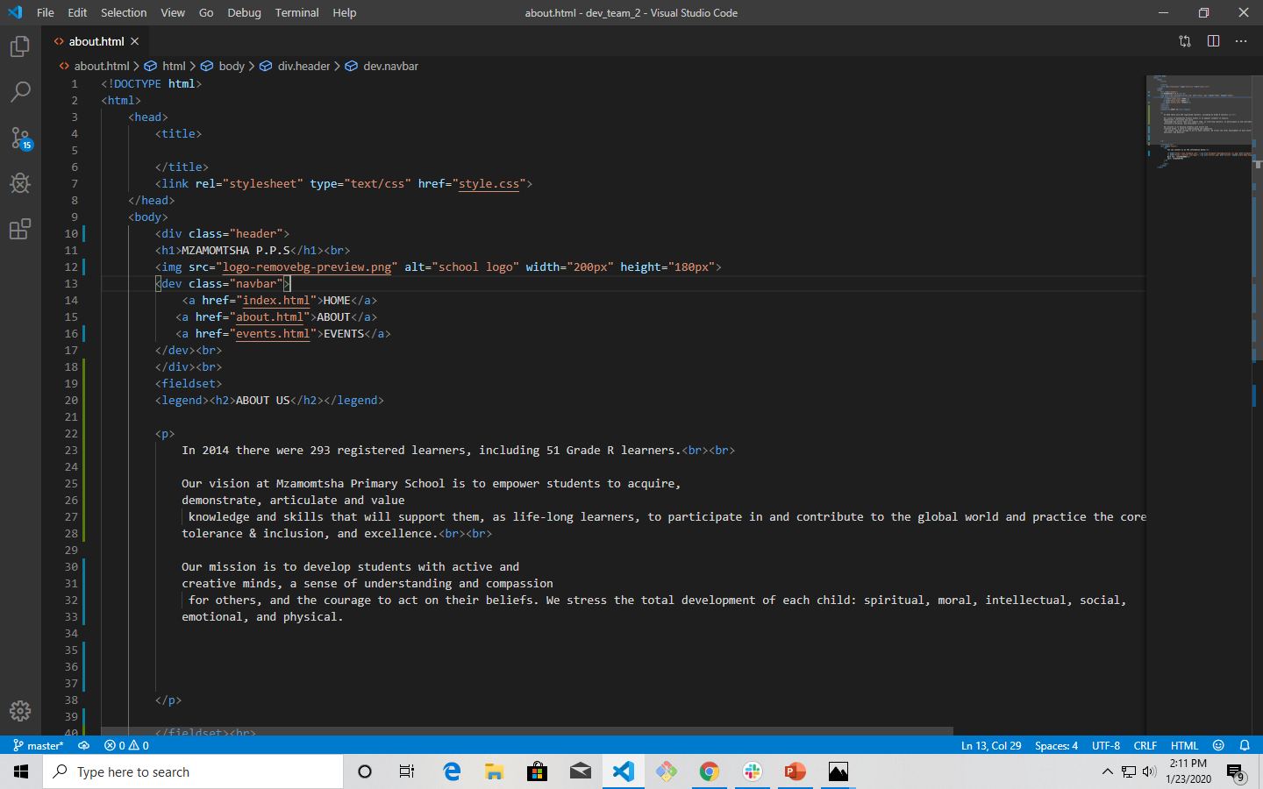
Flexbox About us Page Design

Slide 7
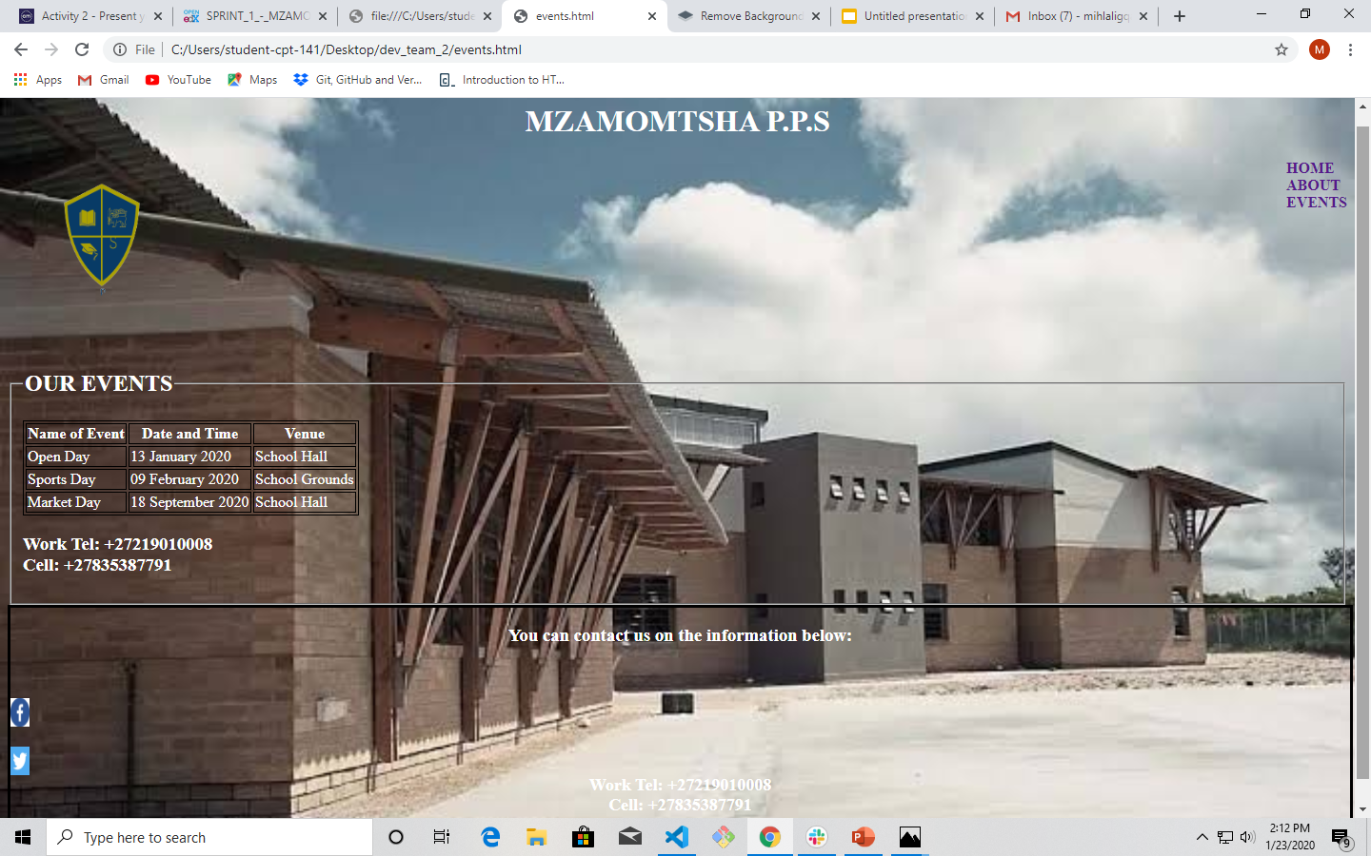
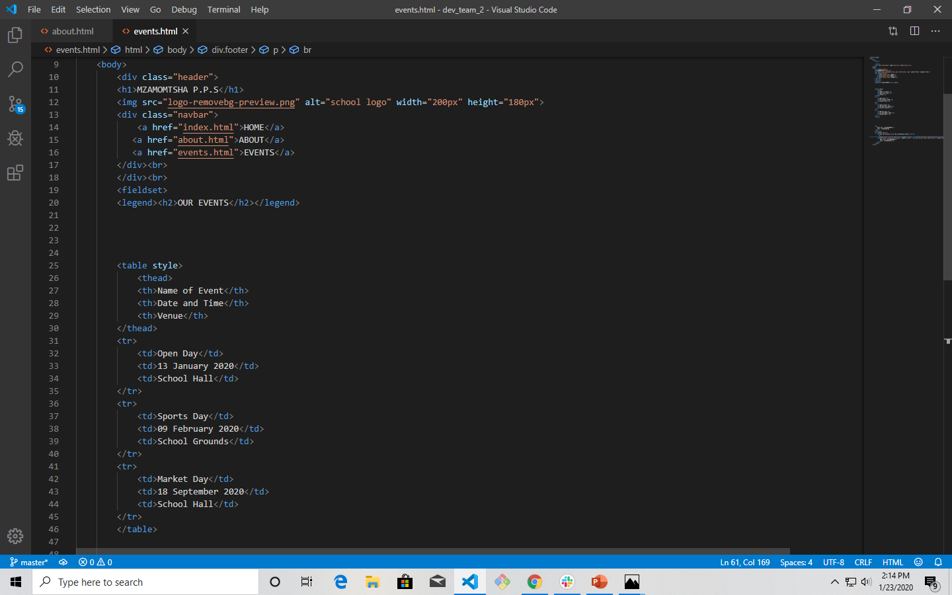
Flexbox Events Page Design

